Slide 1

MICCAI 2019 Journal Club
Dec., 12th, 2019
Minqing Zhang
Notes:
我今天选择三篇论文来讲。

Slide 2
Outline
Pick-and-Learn: Automatic Quality Evaluation for Noisy-Labeled Image Segmentation
Weakly Supervised Segmentation Framework with Uncertainty: A Study on Pneumothorax Segmentation in Chest X-ray
AirwayNet: A Voxel-Connectivity Aware Approach for Accurate Airway Segmentation Using Convolutional Neural Networks
Notes:
第一篇是解决医疗数据中标注存在噪声的问题。第二篇是利用半监督提升模型性能。第三篇是解决气管分割效果不好的问题。
这三篇可能可以给刚开始做医疗影像的同学一些选题方面的启示。

Slide 3
Pick-and-Learn: Automatic Quality Evaluation for Noisy-Labeled Image Segmentation
Haidong Zhu¹, Jialin Shi¹, and Ji Wu^{1,2}
1 Department of Electronic Engineering, Tsinghua University, Beijing, China
2 Institute for Precision Medicine, Tsinghua University, Beijing, China
Notes:
第一篇论文来自清华，属于没事找事，自己想问题，自己造数据来做

Slide 4
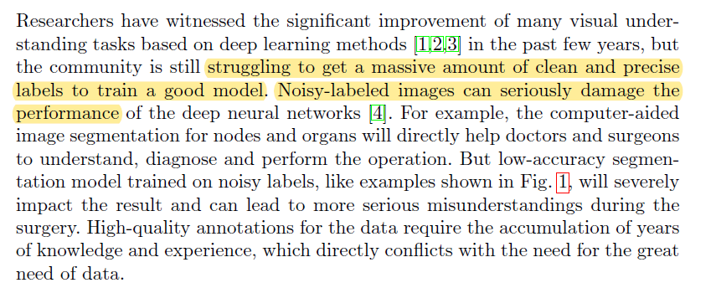
Introduction - background

Slide 5
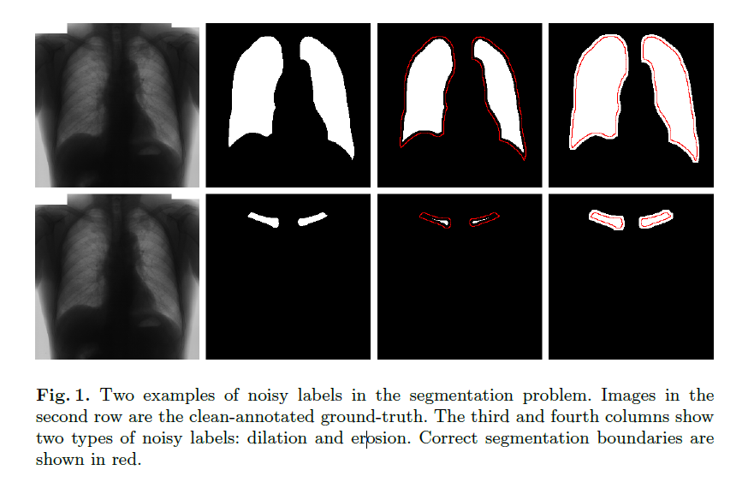
Introduction - background

Slide 6
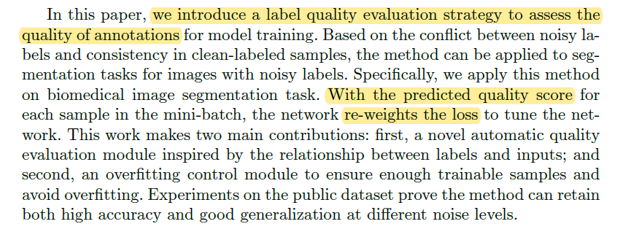
Introduction - contribution

Slide 7
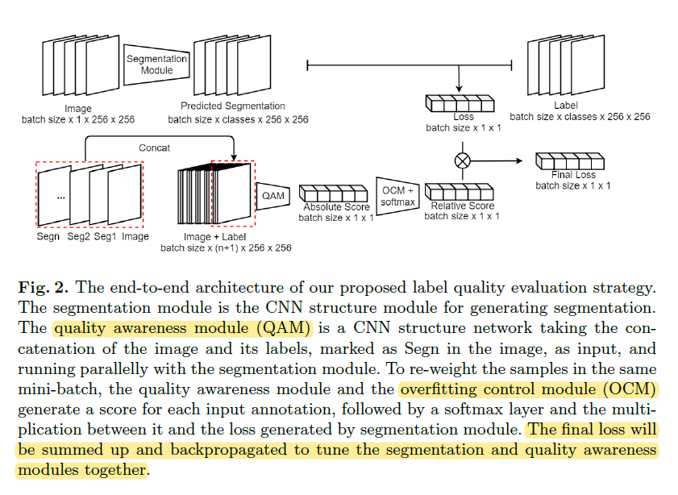
Method - pipeline

Slide 8
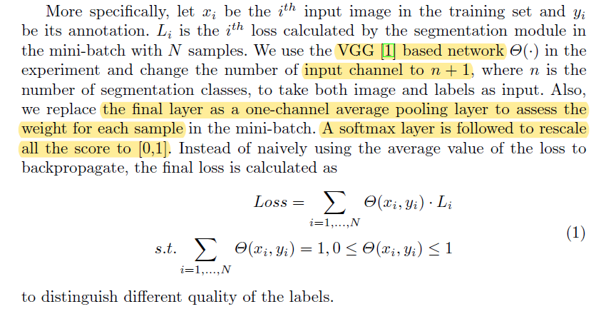
Method - QAM

Slide 9
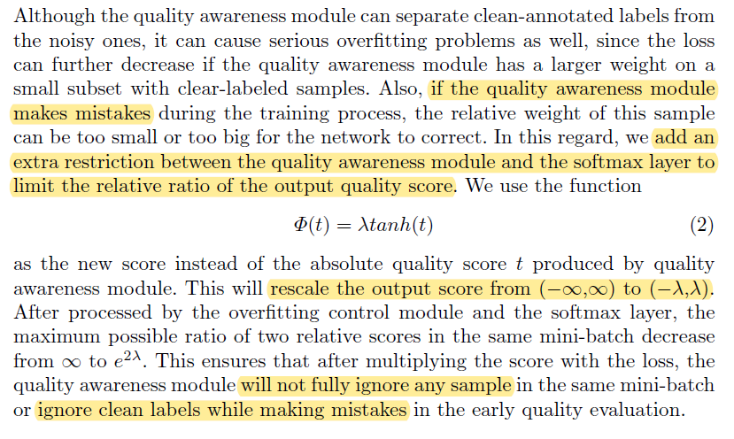
Method - OCM

Slide 10
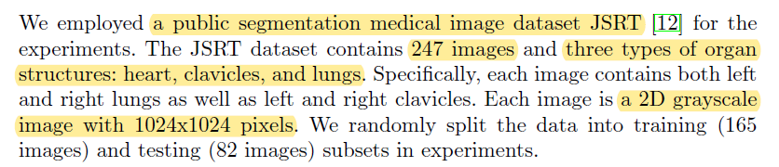
Dataset

Slide 11
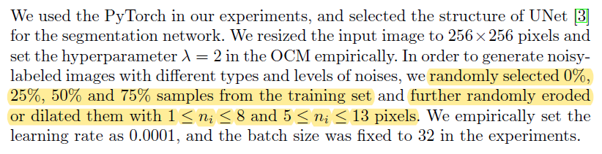
Experiments

Slide 12
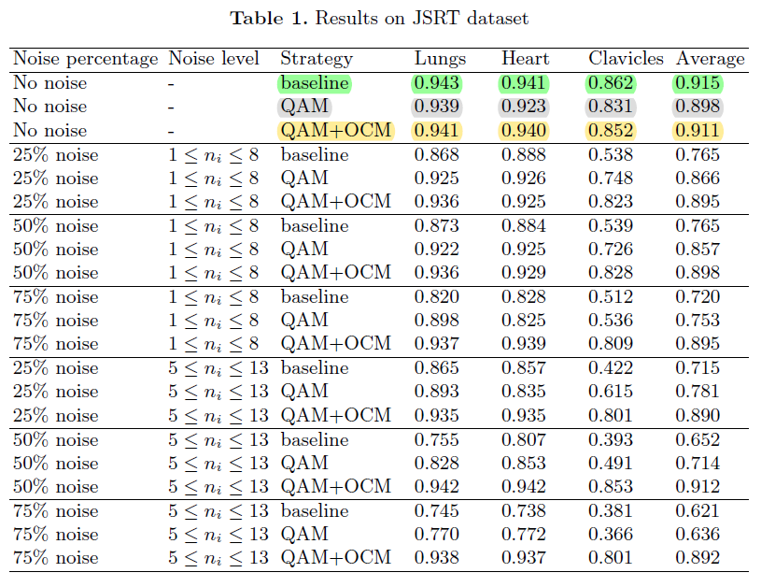
Experiments
Notes:
全都clean的情况下，baseline最好，可能是QAM本身存在犯错可能，导致模型ignore了某些case导致学的样本偏少，因此泛化性降。OCM减轻了这样的问题。

Slide 13
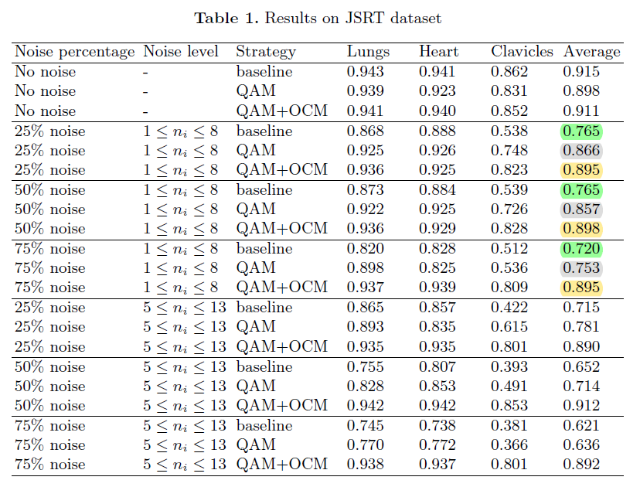
Experiments

Slide 14
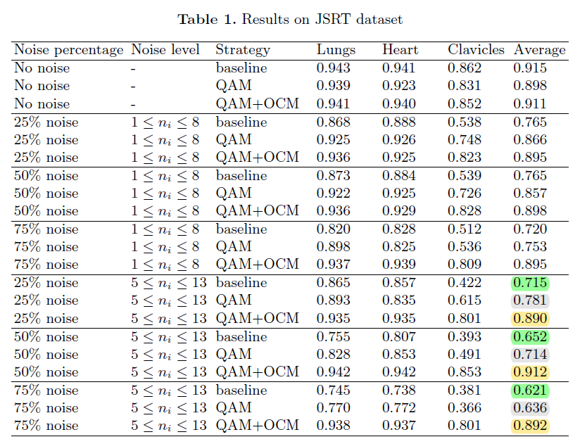
Experiments

Slide 15
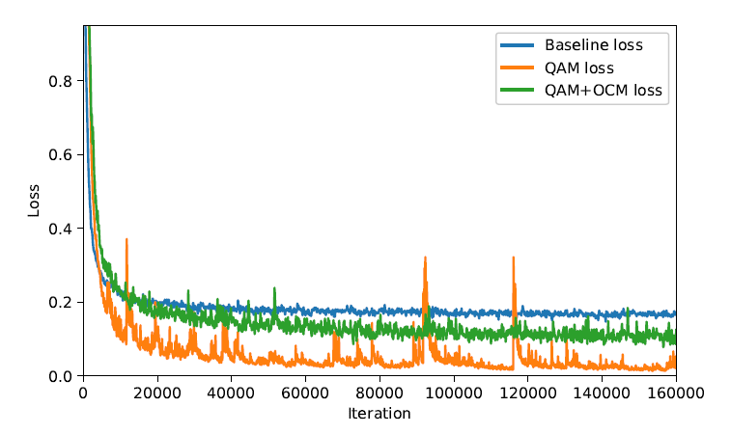
Experiments

Slide 16
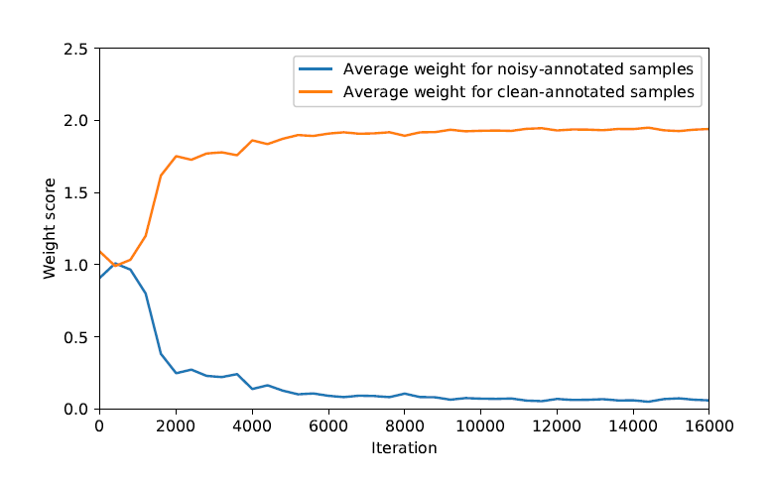
Experiments

Slide 17
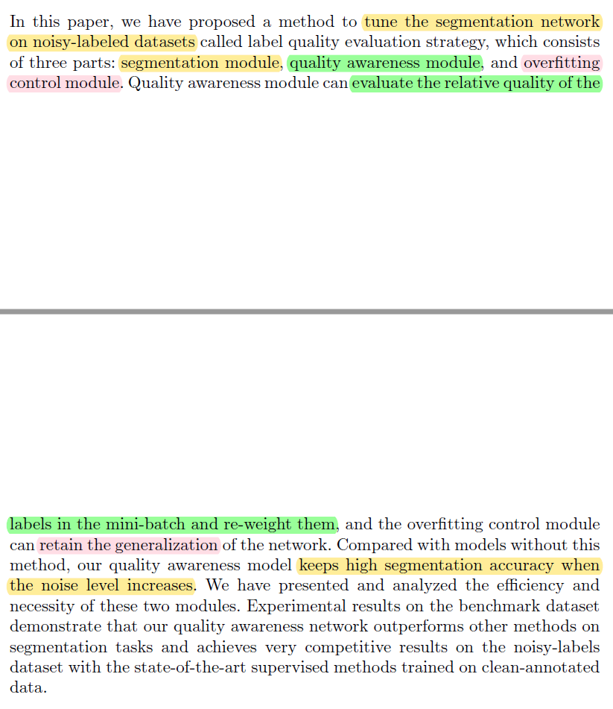
Conclusion

Slide 18
Personal opinion
The noisy data in this paper was manually generated through controllable erosion/dilation process, which is evenly distributed and roughly correct in position. However, the actual noisy data suffer from complicated circumstances, such as FP, FN, and mismatch in position. Therefore, the performance on the actual noisy data remains unknown.
The QAM seems a too naive way to estimate label quality, which is proved to be feasible in assess organ labelling in this paper. But I doubt that whether it would also work on discriminating qualified/unqualified labels of lesion.

Slide 19
Weakly Supervised Segmentation Framework
with Uncertainty: A Study on Pneumothorax Segmentation in Chest X-ray
Xi Ouyang^{1,2}, Zhong Xue¹, Yiqiang Zhan¹, Xiang Sean Zhou¹, Qingfeng Wang³, Ying Zhou⁴, Qian Wang², and Jie-Zhi Cheng¹
1 Shanghai United Imaging Intelligence Co., Ltd., China
2 Institute for Medical Imaging Technology, School of Biomedical Engineering, Shanghai Jiao Tong University, Shanghai, China
3 School of Computer Science and Technology, Southwest University of Science and Technology, Mianyang, China
4 Radiology Department, Mianyang Central Hospital, Mianyang, China
Notes:
和医院合作，帮助发现并解决医院实际问题

Slide 20
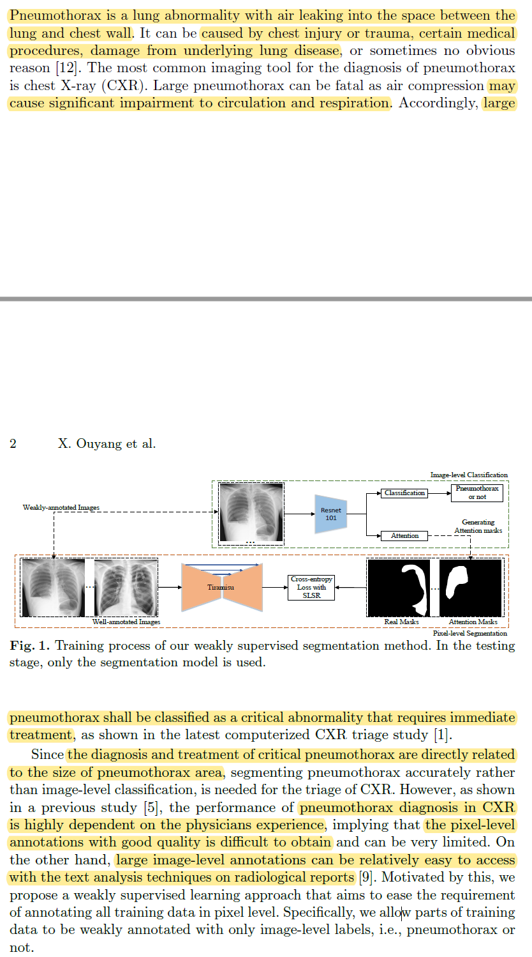
Introduction - background

Slide 21
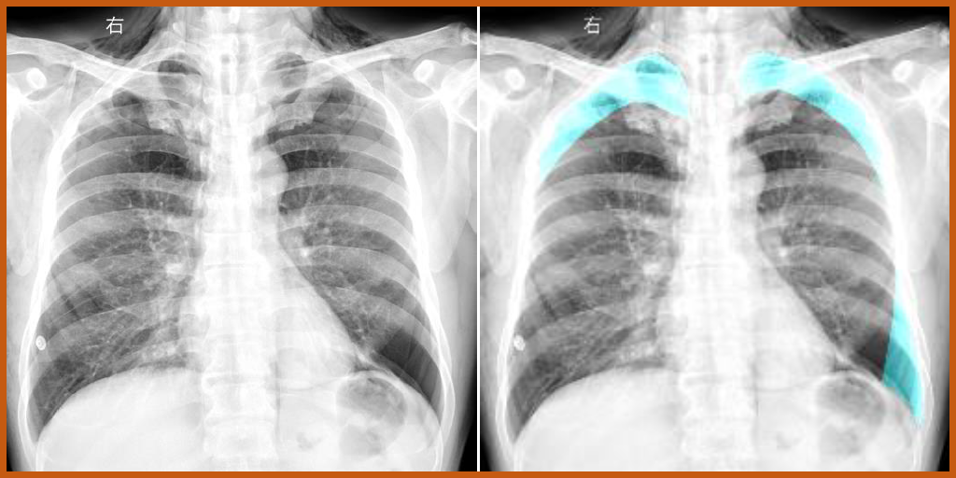
Introduction - background

Slide 22
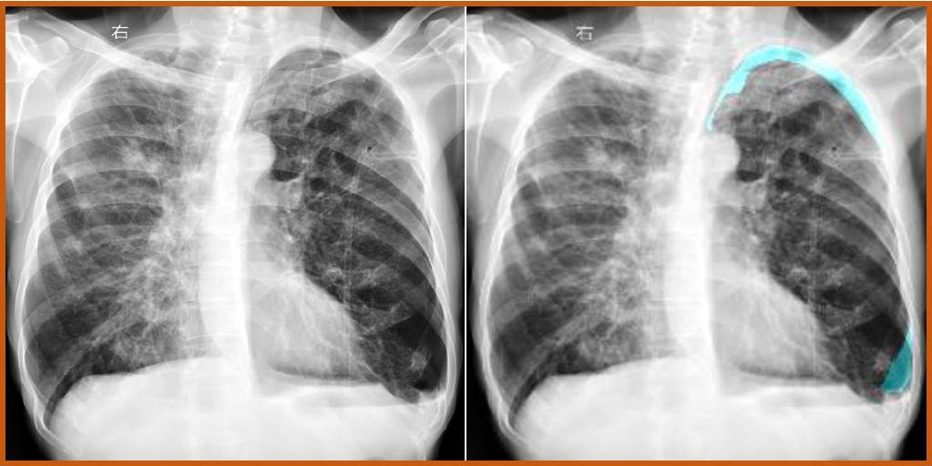
Introduction - background

Slide 23
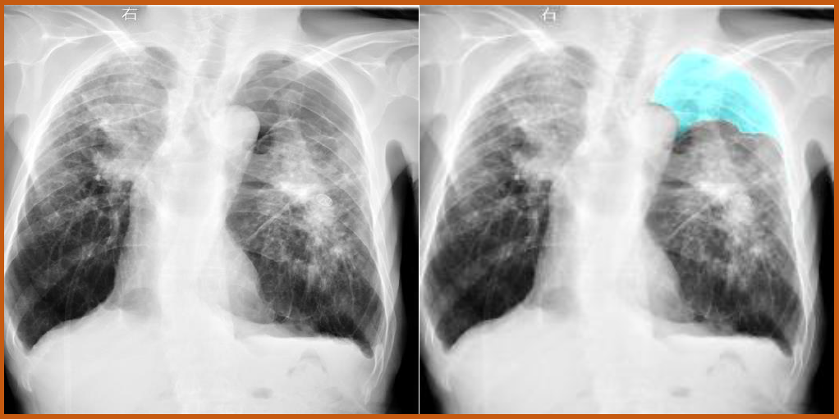
Introduction - background

Slide 24
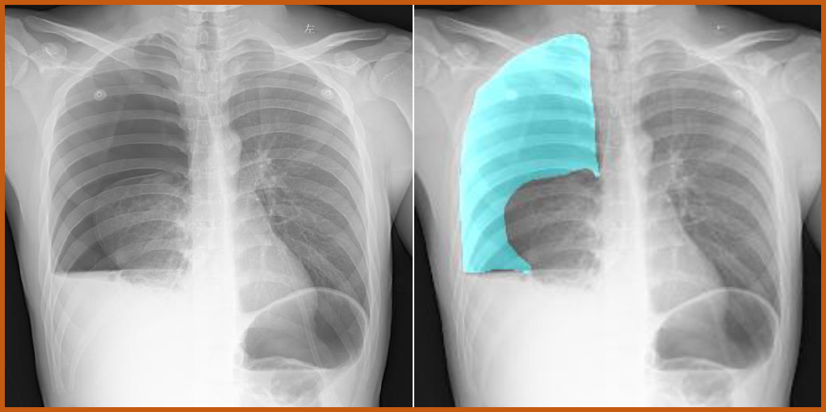
Introduction - background

Slide 25
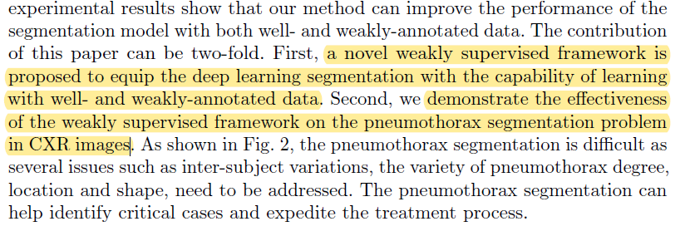
Introduction - contribution

Slide 26
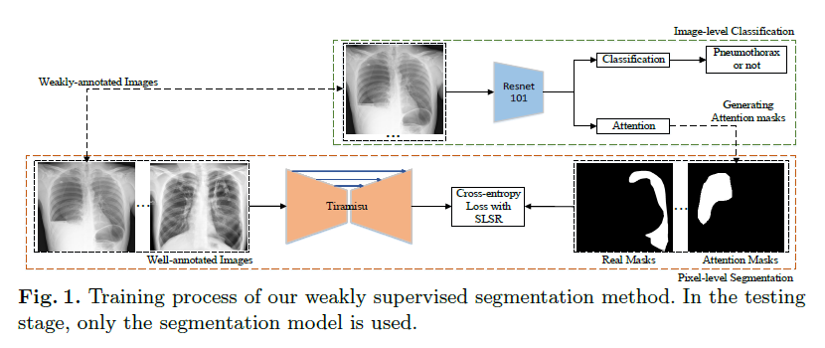
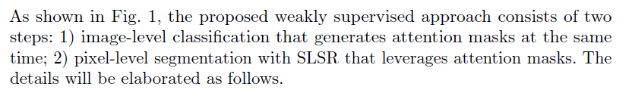
Method - pipeline

Slide 27
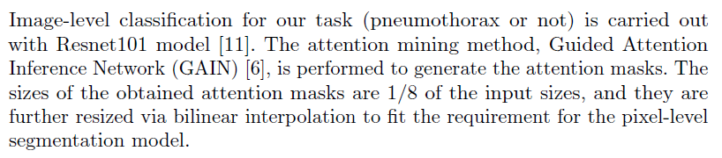
Method - Image-level classification

Slide 28
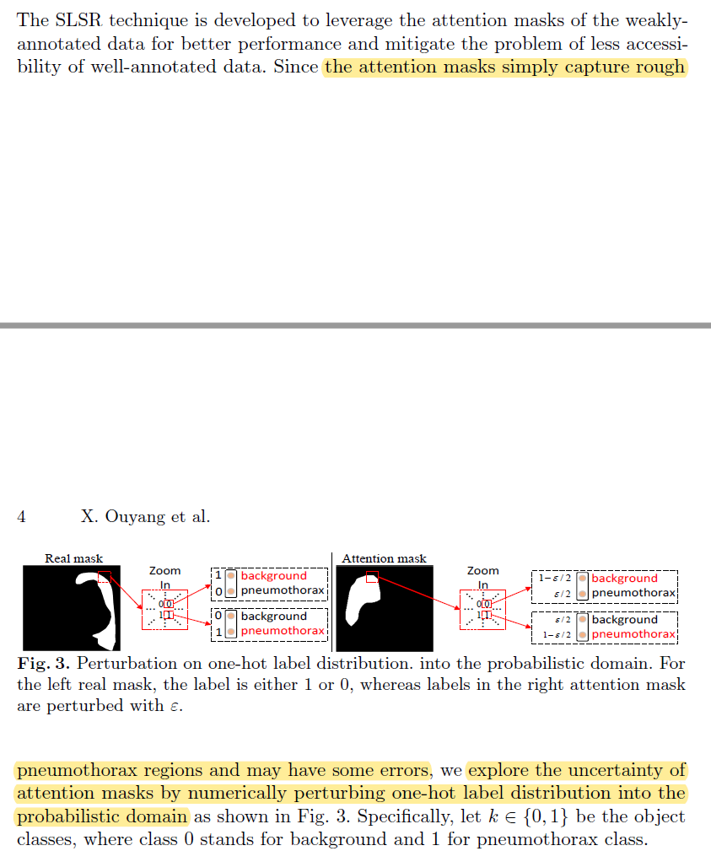
Method - pixel-level segmentation

Slide 29
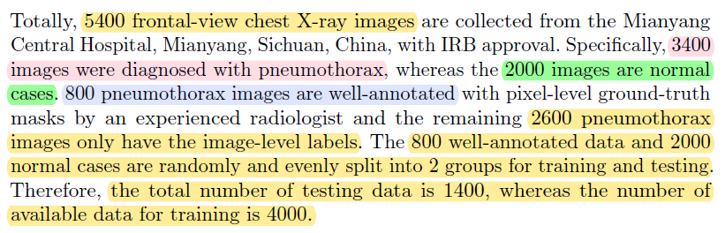
Dataset

Slide 30
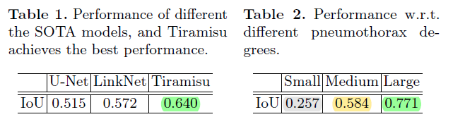
Experiments

Slide 31
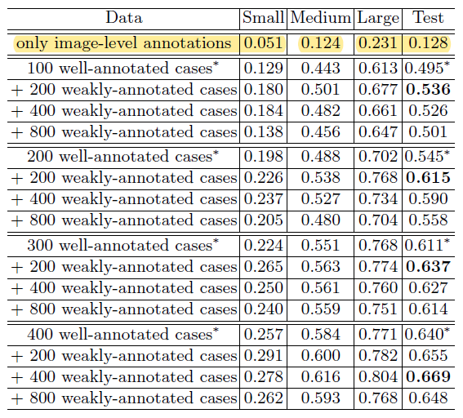
Experiments
Notes:
全都clean的情况下，baseline最好，可能是QAM本身存在犯错可能，导致模型ignore了某些case导致学的样本偏少，因此泛化性降。OCM减轻了这样的问题。

Slide 32
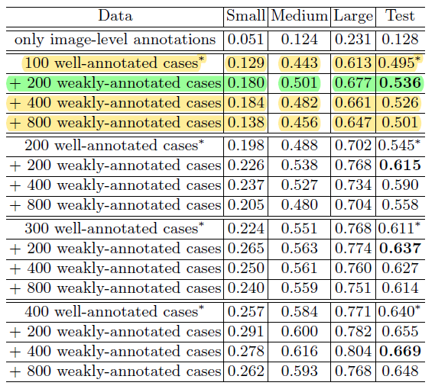
Experiments
Notes:
全都clean的情况下，baseline最好，可能是QAM本身存在犯错可能，导致模型ignore了某些case导致学的样本偏少，因此泛化性降。OCM减轻了这样的问题。

Slide 33
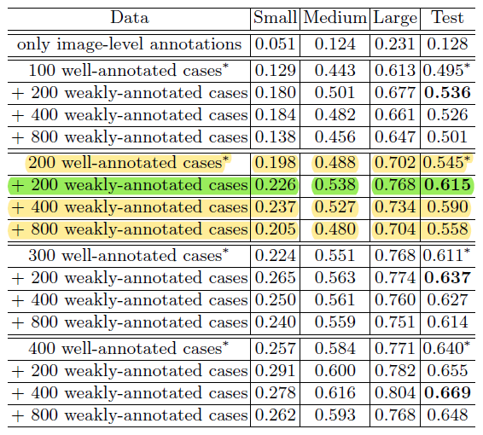
Experiments

Slide 34
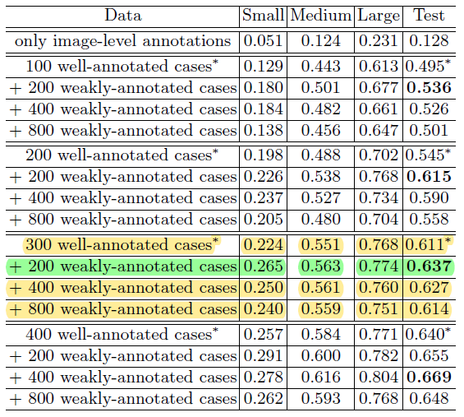
Experiments

Slide 35
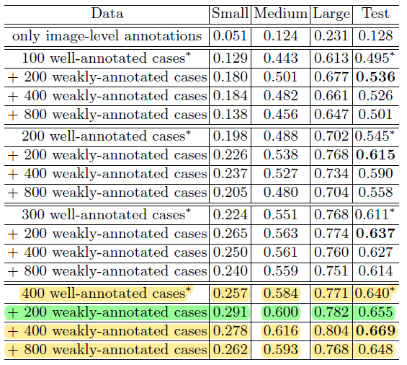
Experiments

Slide 36
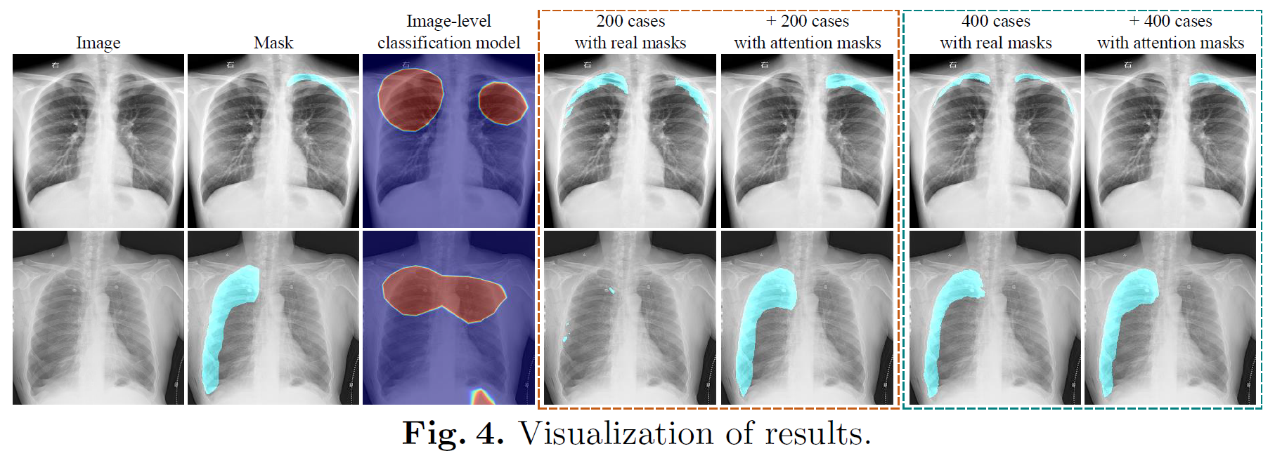
Visualization of results

Slide 37
Personal opinion
The output of the segmentation model trained on well-annotated data can help improve the performance of attention masks generated by CAM.

Slide 38
AirwayNet: A Voxel-Connectivity Aware Approach for Accurate Airway Segmentation Using Convolutional Neural Networks
Yulei Qin^{1,2}, Mingjian Chen^{1,2}, Hao Zheng^{1,2}, Yun Gu^{1,2}, Mali Shen⁴, Jie Yang^{1,2}, Xiaolin Huang^{1,2}, Yue-Min Zhu³, and Guang-Zhong Yang^{2,4}
1 Institute of Image Processing and Pattern Recognition, Shanghai Jiao Tong University, Shanghai, China
2 Institute of Medical Robotics, Shanghai Jiao Tong University, Shanghai, China
3 CREATIS (CNRS UMR 5220, INSERM U1206), INSA Lyon, Lyon, France
4 Hamlyn Centre for Robotic Surgery, Imperial College London, London, UK
Notes:
解决已经存在的问题

Slide 39
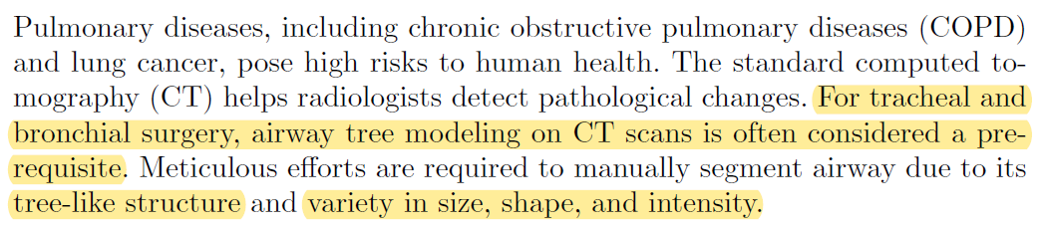
Introduction - background

Slide 40
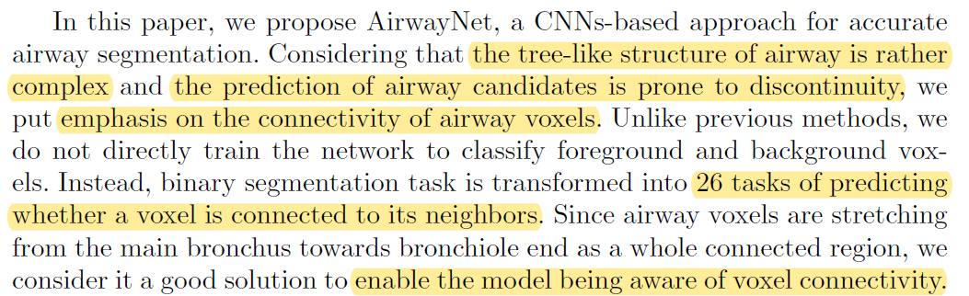
Introduction - background

Slide 41
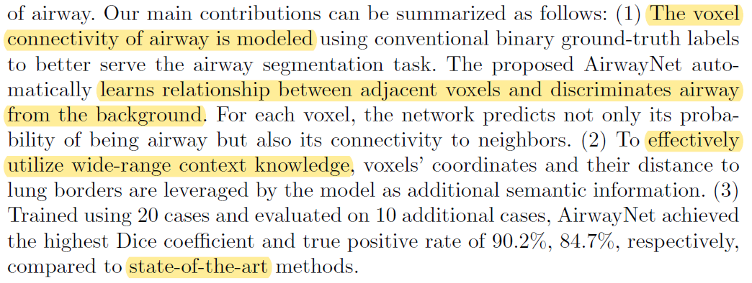
Introduction - contribution

Slide 42
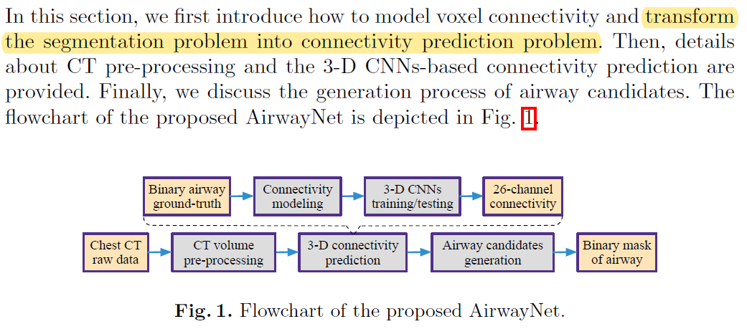
Method - pipeline

Slide 43
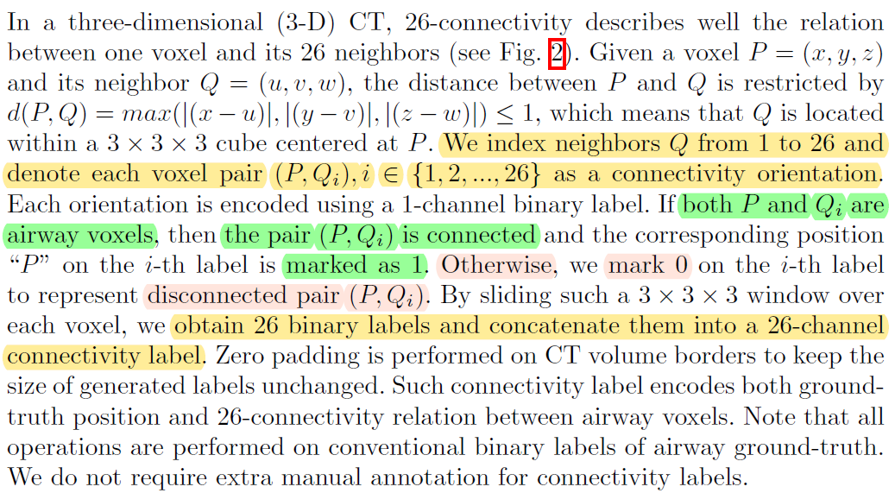
Method - Connectivity Modeling

Slide 44
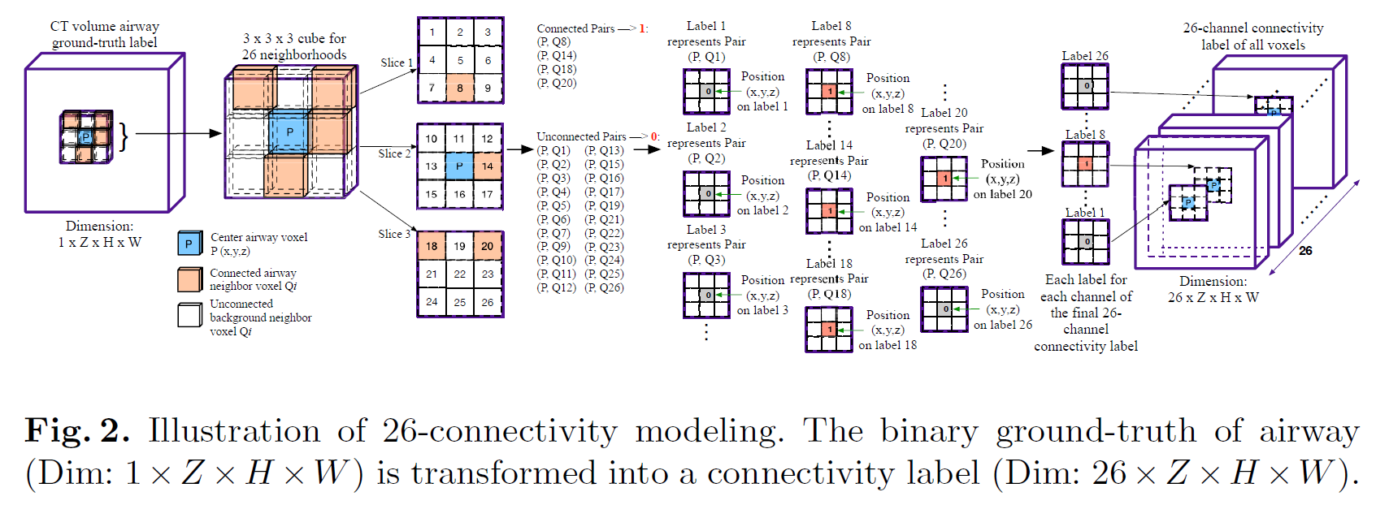
Method - Connectivity Modeling

Slide 45
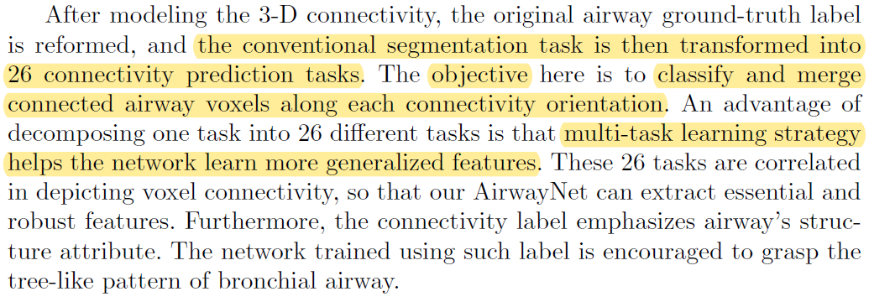
Method - Connectivity Modeling

Slide 46
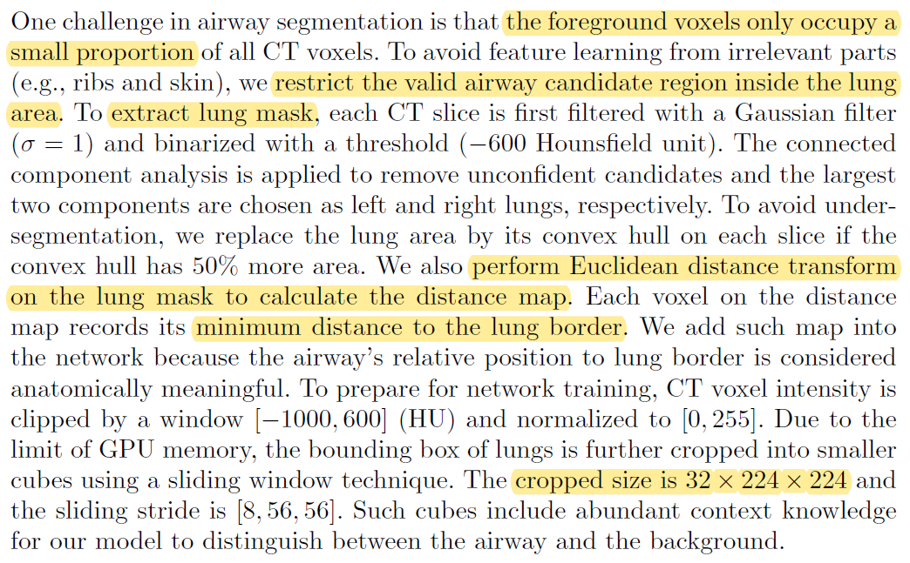
Method - CT volume pre-processing

Slide 47
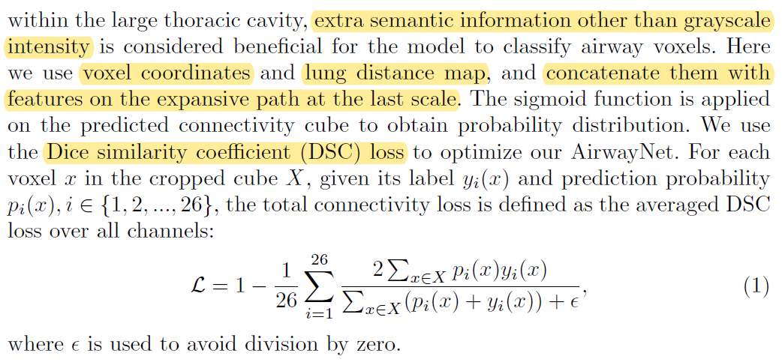
Method - connectivity prediction based on 3-D CNNs

Slide 48
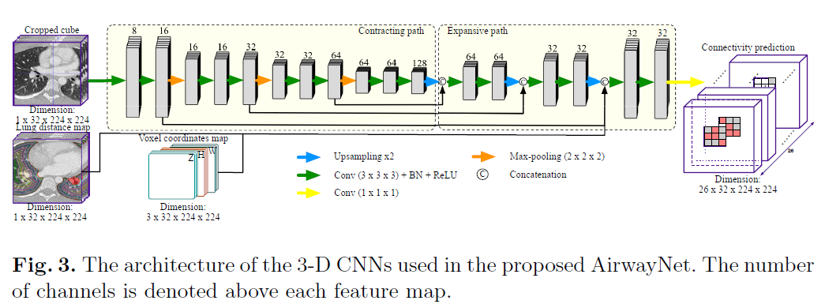
Method - connectivity prediction based on 3-D CNNs

Slide 49
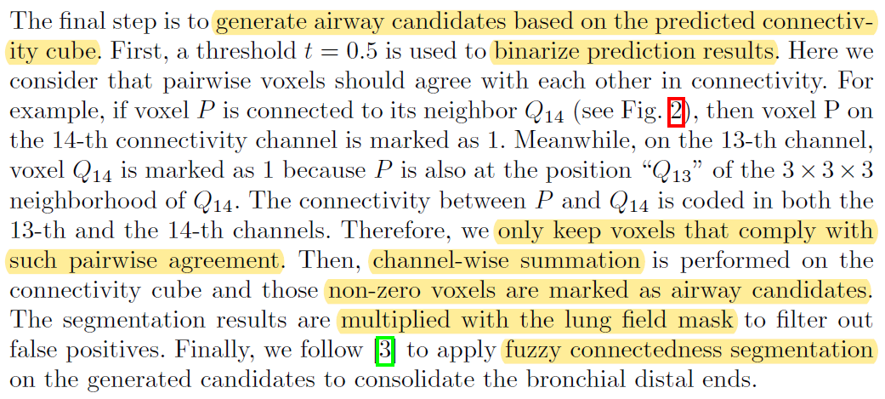
Method - airway candidates generation

Slide 50
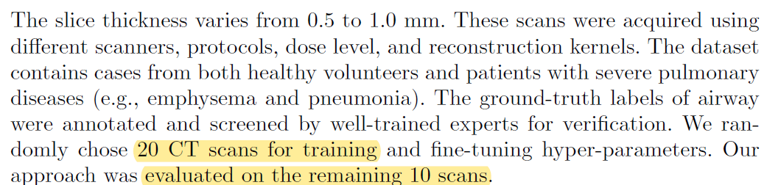
Dataset

Slide 51
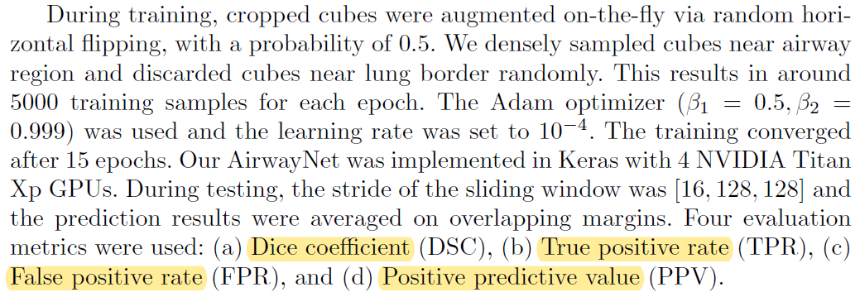
Experiments

Slide 52
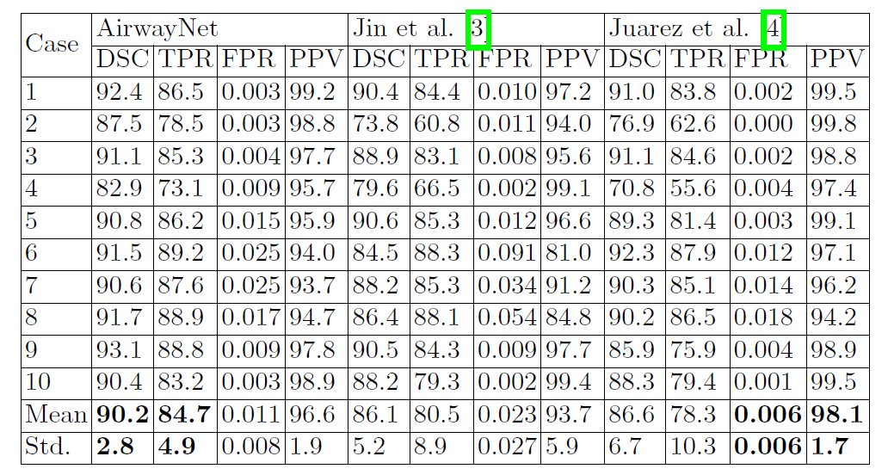
Experiments
Notes:
全都clean的情况下，baseline最好，可能是QAM本身存在犯错可能，导致模型ignore了某些case导致学的样本偏少，因此泛化性降。OCM减轻了这样的问题。

Slide 53
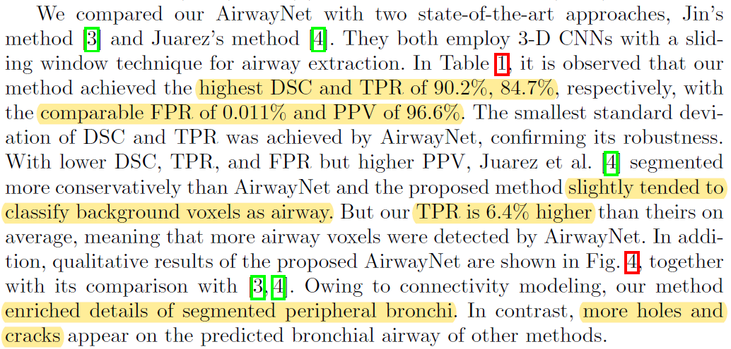
Experiments
Notes:
全都clean的情况下，baseline最好，可能是QAM本身存在犯错可能，导致模型ignore了某些case导致学的样本偏少，因此泛化性降。OCM减轻了这样的问题。

Slide 54
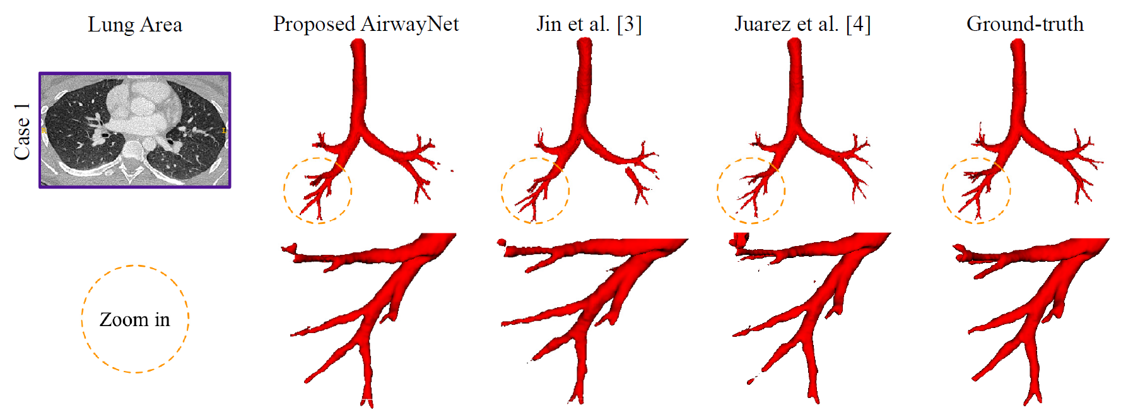
Visualization of results

Slide 55
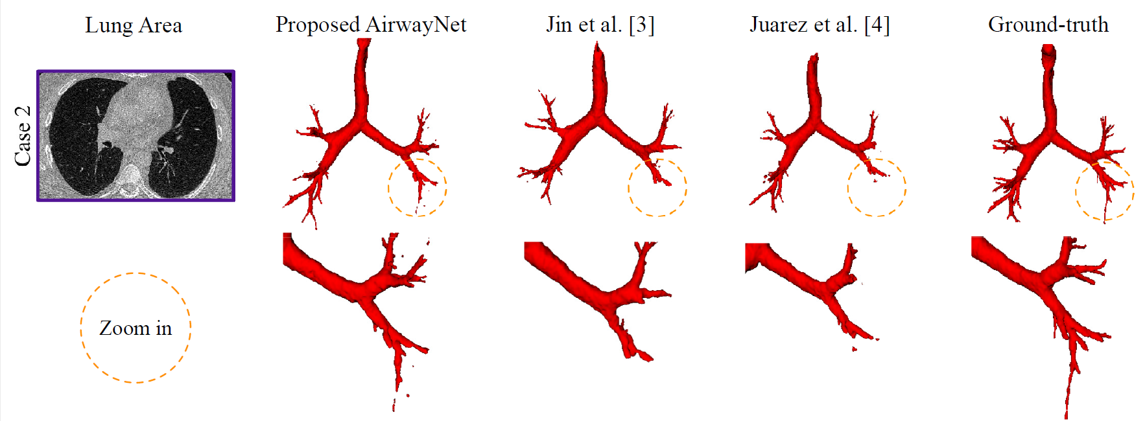
Visualization of results

Slide 56
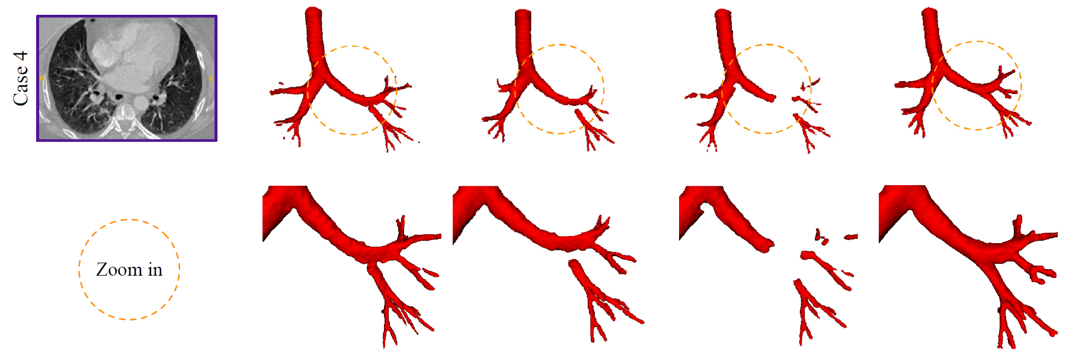
Visualization of results

Slide 57

Visualization of results

Slide 58


Experiments

Slide 59

Experiments
Notes:
TPR = TP / (TP + FN); Recall rate; 阳性样本有多少被找出来 = sensitivity
FPR = FP / (FP + TN); 阴性样本有多少被找错了 = 1-specificity
PPV = TP/ (TP + FP); 预测为阳性样本有多少正确

Slide 60


Conclusion

Slide 61
Personal opinion
The airway segmentation task seems to be suitable for being formulated as point-cloud segmentation.

Slide 62
Thank You!

